Slide 1


Household Hazardous Waste Days and Public Awareness of Hazardous Waste
Makayla McKibben
DSC500
07.24.2024
https://www.clarionsafety.com/products/safety-labels/chemical-hazard-labels/skull-and-crossbones-label-ghs6244-hazard-labels

Slide 2
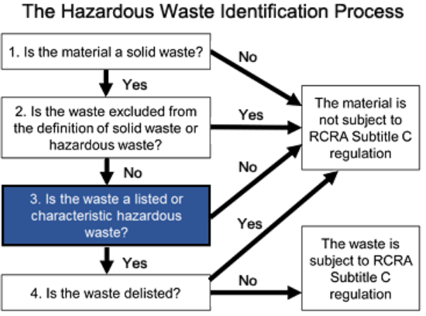
What is Hazardous waste?
Hazardous waste is regulated by the Resource Conservation and Recovery Act
Hazardous waste can fall into three categories
Listed
Characteristic
Mixed Waste

Slide 3
Hazardous waste disposal
Hazardous waste that is subject to RCRA regulations must be disposed of properly
This may include treatment to neutralize the hazard
Placing the waste in a leakproof box called a macro box
Placing the waste in a concrete box, especially if the waste is radioactive

Slide 4
Household hazardous waste disposal
Hazardous waste facilities commonly hold household hazardous waste days
During these days the public may bring hazardous waste from their homes to be properly disposed of
There is a cyclical pattern to the searches
Searches for “Household Hazardous Waste Disposal” peak in April or May
There is a correlation between searches for “Household Hazardous Waste Disposal” and “Hazardous Waste
Google Trends

Slide 5
the cyclical data
Believing that spring cleaning and nicer weather encourage people to clean up and clean out their homes of hazardous waste
Cleaning Agents Batteries
Lead Paint Old Smoke Alarms
Compressed Gases Light Bulbs
Asbestos Mercury Thermometers
Other Hazardous Materials

Slide 6
Pattern of Household Hazardous waste disposal and exposure to hazardous materials
As seen in the graph, searches for “Household Hazardous Waste Disposal” and “Lead Exposure” do not line up neatly
The peaks are offset to either side of each other

Slide 7
Pattern of “Hazardous waste disposal” and “Lead exposure”
As seen in the graph, searches for “Hazardous Waste Disposal” and “Lead Exposure” showed a very close correlation
The peaks are all aligned and reach their maximums and hold them for the same amount of time

Slide 8
conclusions
It is unclear from the current data if there is an impact of "Household Hazardous Waste Days" on public knowledge of Hazard Waste or the resulting illnesses of exposure
"Household Hazardous Waste Disposal" and "Hazardous Waste" align very neatly.
"Household Hazardous Waste Disposal" and "Lead Exposure" do not align with each other.
"Hazardous Waste" and "Lead Exposure" searches align almost perfectly.
These three points beg the question of why the transitive property is not in play. If A + B = C and B + D =C, why is A = D not true? That is to say, if the first and last thing have the same result of being true, and only one variable changed and gave us the same result of true, then why doesn't the variable that changed equal the same thing as the first variable? It means that there must be another variable in play. To answer this question, we will need to look for more data.

